Slide 1

Intro to React.Js
The Widely used Frontend library across the Frontend ecosystem is now being adopted for the headless-commerce Implantation, this intro will serve you as a stepping stone
For you to get started with implantation of frontend using ReactJs.

Slide 2
Day : 1
Intro
Virtual Dom
JSX
Class Components/ Functional Component
State & Props
Events
Managing State in Components

Slide 3
Get started
npx create-react-app my-app
npx create-react-app my-app
Command to create new project
npx create-react-app my-app
Tools
Node/npm
Vscode
Browser

Slide 4
Declarative React makes it painless to create interactive UIs. Design simple views for each state in your application, and React will efficiently update and render just the right components when your data changes.
React A JavaScript library for building user interfaces
Learn Once, Write Anywhere
React can also render on the server using Node and power mobile apps using React Native.
Component-Based
Build encapsulated components that manage their own state, then compose them to make complex UIs.
Since component logic is written in JavaScript instead of templates, you can easily pass rich data through your app and keep state out of the DOM

Slide 5
React Components
Components are like JavaScript functions. They accept arbitrary inputs (called “props”) and return React elements describing what should appear on the screen.
Simple Component
const Greeting = () => <h1>Hello World today!</h1>;
Types of Component
Functional components(Stateless)
Class Components(Stateful)

Slide 6
Functional components
These components are purely presentational and are simply represented by a function that optionally takes props and returns a React element to be rendered to the page
functional components referred to as stateless, dumb or presentational in other literature. All these names are derived from the simple nature that functional components take on.
Functional because they are basically functions
Stateless because they do not hold and/or manage state
Presentational because all they do is output UI elements
const Greeting = () => <h1>Hi, I’m a dumb component!</h1>;

Slide 7
Class Components
These components are created using ES6’s class syntax. They have some additional features such as the ability to contain logic (for example methods that handle onClick events), local state (more on this in the next chapter) and other capabilities to be explored in later sections of the book.
=> Class because they are basically classes
=> Smart because they can contain logic
=> Stateful because they can hold and/or manage local state
=> Container because they usually hold/contain numerous other (mostly functional) components

Slide 8
How to choose which component type to use?
Use a class component if you:
=> need to manage local state
=> need to add lifecycle methods to your component
=> need to add logic for event handlers
Otherwise, always use a functional component.

Slide 9
JSX
JSX stands for JavaScript XML. It is simply a syntax extension of JavaScript. It allows us to directly write HTML in React (within JavaScript code)
whithout JSX this is how we write code to create component React.createElement("h1", { id: "main-title" }, "My Website");
This actually rendered into <h1 id="main-title">My Website</h1>
Using jsx we just can write () => (<h1 id="main-title">My Website</h1>)
What JSX is doing for you. It's just translating those HTML tags into React.createElement calls. That's it. Really. No more magic here. JSX does nothing else. Many people who learn React don't learn this.

Slide 10
VirtualDOM
The virtual DOM (VDOM) is a programming concept where an ideal, or “virtual”, representation of a UI is kept in memory and synced with the “real” DOM by a library such as ReactDOM. This process is called reconciliation.

Slide 11
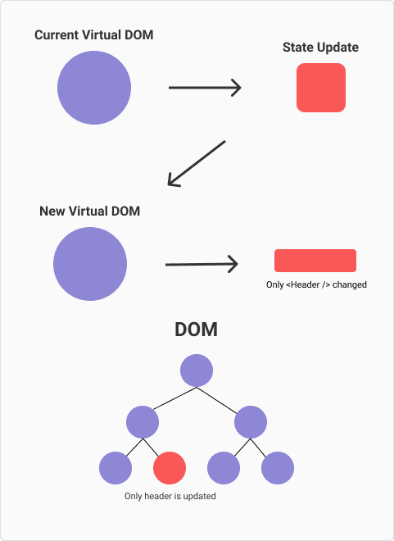
Rendering as the procedure of synchronizing changes in the DOM. React synchronizes the changes in the DOM through three steps.

Slide 12
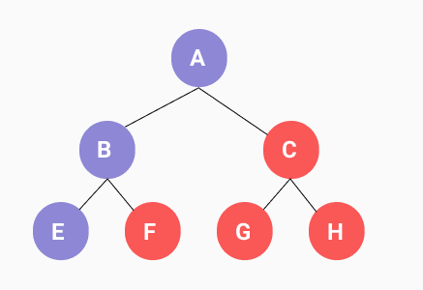
Render Rendering is a process that is triggered by a change of state in some component of your application, when a state change occurs React:
It will collect from the root of your App all the components that requested a re-render because their state or their props changed.

Slide 13
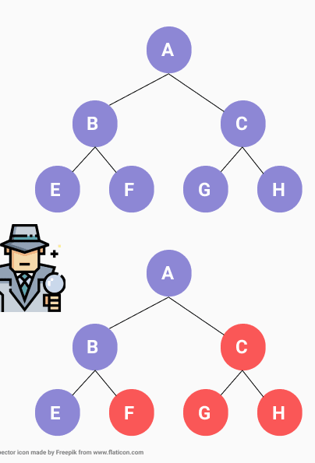
Reconciliation Once the re-rendering has happened, React has the context of two versions of the output, the version React.createElement executed before the state change occurred, and the version executed after the state has changed.
At this point two objects are describing the UI, React through a heuristic algorithm of order O(n^3) will be able to determine which elements need to be represented again.

Slide 14
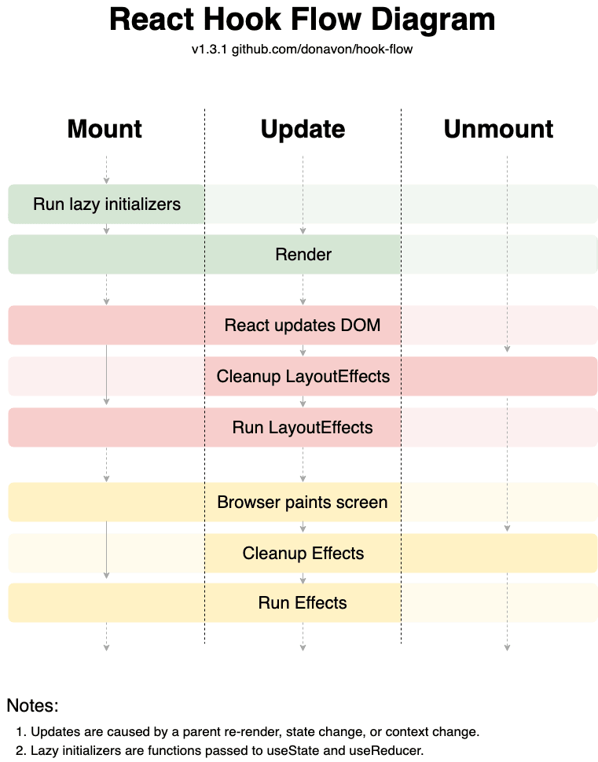
Commit After React calculated all the changes that should be made in the application it Synchronously React will clean up the past layout effects, run the new layout effects, then the browser will paint the DOM, after that, React will clean up the past effects and mount the new ones ree

